Slide 1
HCL Commerce PoC Acceptance Criteria

Slide 2
Version | Who | Update
0.1 | B Rossi | Create deck, define criteria

Slide 3
HCL Commerce PoC Acceptance Criteria

Slide 4
HCL Commerce PoC Acceptance Criteria
01
Description of PoC
04
Share Possible Alternative Options
This section provides a high-level introduction of the Proof of Concept itself.
What other methods, processes or solutions did we consider when developing this PoC?
02
Problem(s) Being Solved / Constraints
05
Share Challenges & Lessons Learned
This section will provide a full description of the use cases and problems the PoC solves.
Throughout the PoC development process, what observations, roadblocks, issues and challenges did we experience and how did we resolve them.
03
What Is the Solution?
06
Document Associated Assets
This section will provide a full description of the system. This should include architectural diagrams where necessary to provide a graphical reference point.
Provide full documentation of any associated assets. This include everything from the code itself to step-by-step documentation on setting up pre-requisites, installing an asset/app, how to run the asset/app as well as an end to end video demonstrating the PoC.

Slide 5
Description of PoC
01
ENTER IN A BRIEF HIGH-LEVEL DESCRIPTION OF THE POC HERE
Purpose: Demonstrate the ability to integrate a REACT-Native application with HCL Commerce v9. The use case is that the user can scan barcodes (CODE-128), add these items to the cart, and prepare for checkout with a registered user.
Use Case:
Enable Customers to Self checkout with Mobile Application
Add scanned products to shopping cart
Shopping
Add / Remove Items from Cart
Checkout
Checkout with Preferred Payments
Checkout with Cash/Charge

Slide 6
Problem(s) Being Solved & Constraints
02
PROVIDE A DESCRIPTION OF THE USE CASE(S) OR BUSINESS PROBLEMS BEING ADDRESSED AS WELL AS ANY CONSTRAINTS.
Use Case:
Enable Customers to Self checkout with Mobile Application
Add scanned products to shopping cart
Shopping
Add / Remove Items from Cart
Checkout
Checkout with Preferred Payments
Checkout with Cash/Charge

Slide 7
What is the Solution?
IN THIS SECTION, PLEASE PROVIDE A FULL DESCRIPTION OF WHAT THE SOLUTION/APPROACH IS. THIS SHOULD INCLUDE ARCHITECTURAL DIAGRAMS WHERE NECESSARY
Mobile Application written in REACT-NATIVE served with expo on iPhone and Android platforms. Communicating with HCL Commerce v9 via REST APIs through an nginx HTTPS termination proxy.
03
HCL BDA v9 Environment
Mobile Device
(react-native node.js)
HTTP REST API
nginx
HTTPS REST API
HCL Commerce v9
Expo Client
react-native
Expo Server Serving up React JavaScript to Expo Client
Expo
Server

Slide 8
Sharing Possible Alternative Options
04
DEFINE ANY ALTERNATIVE APPROACHES OR OPTIONS YOU CONSIDERED
DURING THIS POC
Non-Applicable

Slide 9
Share Challenges & Lessons Learned
05
PROVIDE A DESCRIPTION OF ANY CHALLENGES, OBSTACLES, ROADBLOCKS
ENCOUNTERED.
Self Signed Certs aren’t iPhone Friendly hence the SSL Termination with the nginx server

Slide 10
Document Associated Assets
06
PROVIDE DOCUMENTATION OF ASSETS REQUIRED (CODE/GIT, ETC)
https://github.com/fbooth-elevatus/barcodescanner-example
PROVIDE STEP-BY-STEP DOCUMENTATION ON SETTINGS UP PRE-REQUISITES, INSTALLING ASSET AND HOW TO RUN THE ASSET/APP.
https://hclo365-my.sharepoint.com/:w:/r/personal/francis_booth_hcl_com/_layouts/15/Doc.aspx?sourcedoc=%7BCF50196F-E568-42E9-A15B-73F25C208A33%7D&file=BarcodeScanning%20Application%20-%20Shopand%20Go%20POC.docx&action=default&mobileredirect=true
END TO END VIDEO OF DEMONSTRATION

Slide 11
Document Associated Assets
06
PROVIDE DOCUMENTATION OF ASSETS REQUIRED (CODE/GIT, ETC)
https://github.com/fbooth-elevatus/barcodescanner-example
PROVIDE STEP-BY-STEP DOCUMENTATION ON SETTINGS UP PRE-REQUISITES, INSTALLING ASSET AND HOW TO RUN THE ASSET/APP.
https://hclo365-my.sharepoint.com/:w:/r/personal/francis_booth_hcl_com/_layouts/15/Doc.aspx?sourcedoc=%7BCF50196F-E568-42E9-A15B-73F25C208A33%7D&file=BarcodeScanning%20Application%20-%20Shopand%20Go%20POC.docx&action=default&mobileredirect=true
END TO END VIDEO OF DEMONSTRATION – NEXT PAGE

Slide 12
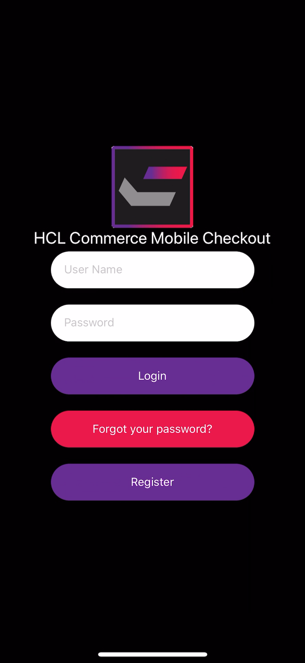
Document Associated Assets
06
PROVIDE DOCUMENTATION OF ASSETS REQUIRED (CODE/GIT, ETC)
https://github.com/fbooth-elevatus/barcodescanner-example
PROVIDE STEP-BY-STEP DOCUMENTATION ON SETTINGS UP PRE-REQUISITES, INSTALLING ASSET AND HOW TO RUN THE ASSET/APP.
https://hclo365-my.sharepoint.com/:w:/r/personal/francis_booth_hcl_com/_layouts/15/Doc.aspx?sourcedoc=%7BCF50196F-E568-42E9-A15B-73F25C208A33%7D&file=BarcodeScanning%20Application%20-%20Shopand%20Go%20POC.docx&action=default&mobileredirect=true
END TO END VIDEO OF DEMONSTRATION

